Slide 1
Year 10 PreATAR Science
Ions

Slide 2
Review
Draw an atom of magnesium, showing all protons, neutrons and electrons (in shells)
List the properties of metals
Explain why metals can conduct electricity (use a diagram if you need to)

Slide 3
Learning Intention
Use an element’s position in the Periodic Table to determine which ions it will form.

Slide 4
Success criteria
State that all metals form positive ions
Write the formula for metal ions
State that all non-metals form negative ions
Write the formula for non-metal ions
Highlight the list of ions which can’t be determined by looking on a Periodic Table

Slide 5
Neutral atoms
Neutral atoms have the same number of electrons and protons
12⁺
magnesium Mg 2,8,2
12 electrons ⁻ 12 protons +

Slide 6
Ions
ions are atoms that have an unequal number of electrons and protons
atoms gain or lose electrons to become ions
number of protons DOES NOT change

Slide 7

Positive ions form by losing electrons
12⁺
12⁺
magnesium Mg 2,8,2
12 electrons ⁻ 12 protons +
magnesium Mg²⁺ 2,8
10 electrons - 12 protons +

Slide 8
ions
Mg
Mg²⁺
Neutral atom
Atomic number = 12
Protons = 12
Electrons = 12
Equal protons and electrons give no charge
Positive ion
Atomic number = 12
Protons = 12
Electrons = 10
Two fewer electrons gives an overall charge of 2+

Slide 9
Negative ions form by gaining extra electrons
17⁺
17⁺
chlorine Cl 2,8,7
17 electrons ⁻ 17 protons +
chlorine Cl⁻ 2,8,8
18 electrons ⁻ 17 protons +

Slide 10
ions
Cl
Cl⁻
Neutral atom
Atomic number = 17
Protons = 17
Electrons = 17
Equal protons and electrons give no charge
Negative ion
Atomic number = 17
Protons = 17
Electrons = 18
One extra electron gives an overall charge of 1-

Slide 11
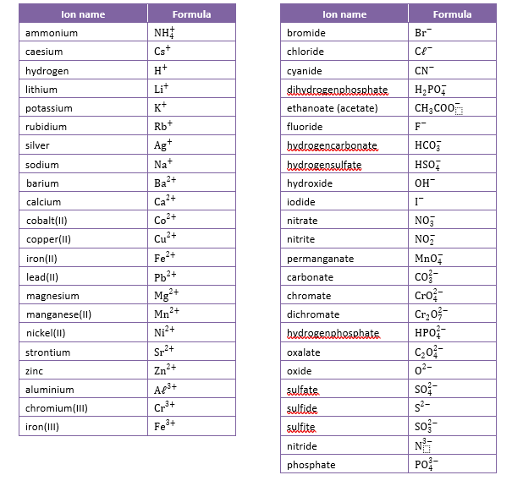

Slide 12
Ions and the Periodic Table
Group 1 are +1 eg Na⁺
Group 2 are +2 eg Mg⁺²
Group 17 are -1 eg Cl⁻
Group 16 are -2 eg O⁻²
Group 15 are -3 eg N⁻³

Slide 14
Multivalent Ions
Transition metals can often form more than one type of ion, with different charges
eg Cu⁺ and Cu⁺²
Fe⁺² and Fe⁺³
These use roman numerals in their name to indicate which charge

Slide 16
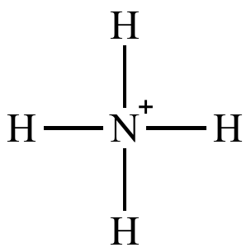
Polyatomic ions
Groups of atoms can also gain or lose electrons to form ions – poly means many
eg ammonium NH₄⁺

Slide 18
Success criteria
State that all metals form positive ions
Write the formula for metal ions
State that all non-metals form negative ions
Write the formula for non-metal ions
Highlight the list of ions which can’t be determined by looking on a Periodic Table

